Slide 1

OLIST STORE (E – COMMERCE) ANALYSIS

Slide 2
P .Jithendra Reddy
A. Santhi Priya
K. Sukanya
MB . Arpitha
B. Uma Maheshwari
G. Harashavardan
P_387 - Group 2 (Project Team Members)
P .Jithendra Reddy
A. Santhi Priya
K. Sukanya
MB . Arpitha
B. Uma Maheshwari
G. Harashavardan
B. Srikanth

Slide 3

Index
INTRODUCTION
KPI -1 : Weekday Vs Weekend payment Statistics.
KPI -2 : No. of Orders by review score 5 and payment type credit card.
KPI -3 : Avg no .of days taken for order delivery for pet shop.
KPI -4 : Avg Price and Avg Payments for Sao Paulo city.
KPI -5 : Average Shipping days Vs Review score.
Excel Dashboard.
Tableau Dashboard.
Power BI Dashboard.
SQL .
Challenges faced.
Conclusion

Slide 4
KPI 1
Weekday Vs Weekend payment Statistics
Insights:
Total Payments: $16.01 Million
Weekday Payments: $3.64 Million (23%)
Weekend Payments: $12.37 Million (77%)
Recommendations:
Weekends: Implement Offers and Discounts to Boost Revenue and Balance Payment Distribution.
Mondays: Launch New Products to Capitalize on Higher Payment Volumes.

Slide 5
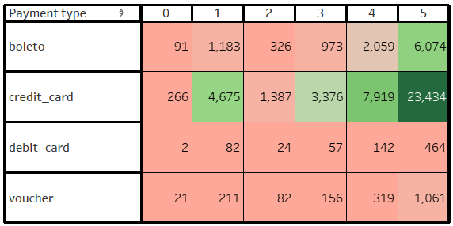
KPI 2
No. of Orders by review score 5 and payment type credit card
Insights:
Review Score "5" Orders with Credit Card Payments: 314348
Highest No. of Orders Rated "5": 314348
Highest Credit Card Payments: 76,600
Recommendations:
Addressing Low Ratings: 11,97 orders received a score of "1," potentially due to quality issues or delivery delays.
Improving Delivery Speed: By reducing shipping days, we can enhance the speed of order fulfillment.
Focus on Quality: Emphasize improving product quality to mitigate issues leading to a score of "1".

Slide 6
KPI 3
Avg no .of days taken for order delivery for pet shop
Avg Delivery
(Pet shop)
​ 11 Days
Insights:
High customer satisfaction evidenced by 3575reviews scoring 5 out of 5 on the 8th day.
Average delivery time for pet shop category is 11 days, indicating standard expectations for delivery.
Recommendations:
Maintain quality standards to uphold customer satisfaction.
Streamline delivery processes to potentially improve efficiency.
Monitor and respond to customer feedback for continual improvement.
Offer additional value-added services or benefits to enhance the customer experience.

Slide 7
KPI 4
Avg Price and Avg Payments for Sao Paulo city
Insights:
The average price in Sao Paulo city is $109.63, while the average payment is $135.79. Both average prices and payments have been steadily increasing each year.
Recommendations:
Olist should prioritize enhancing the purchasing and delivery processes within Sao Paulo city and work towards improving transaction experiences in other cities.

Slide 8
KPI 5
No. of Orders by review score 5 and payment type credit card
Insights:
The relationship between shipping days and review scores is inversely proportional.
Recommendations:
Olist should focus on improving its logistics service to reduce delivery times and shipping days. Additionally, the company should strive to supply high-quality products

Slide 9
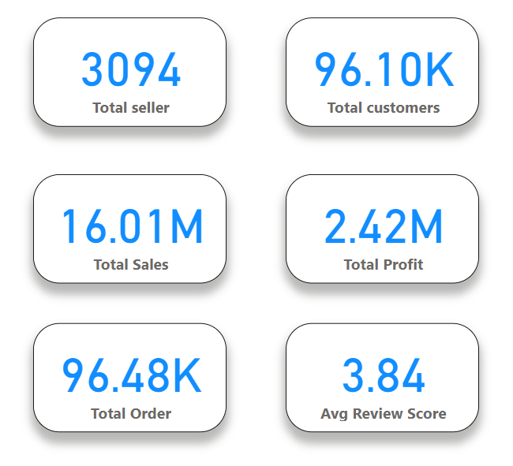
Olist Store E-commers overall data:

Slide 10
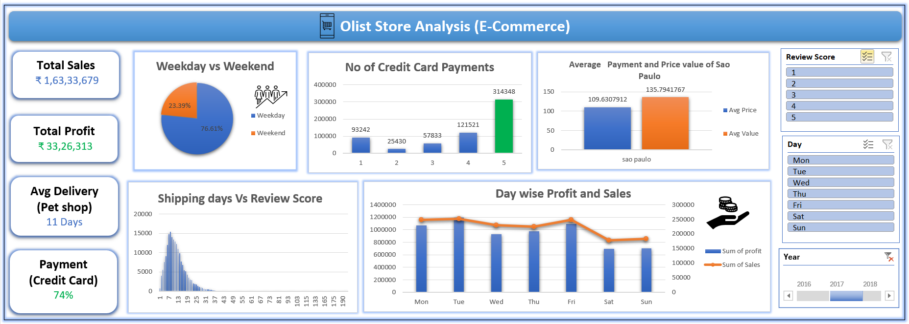
Excel Dashboard

Slide 11
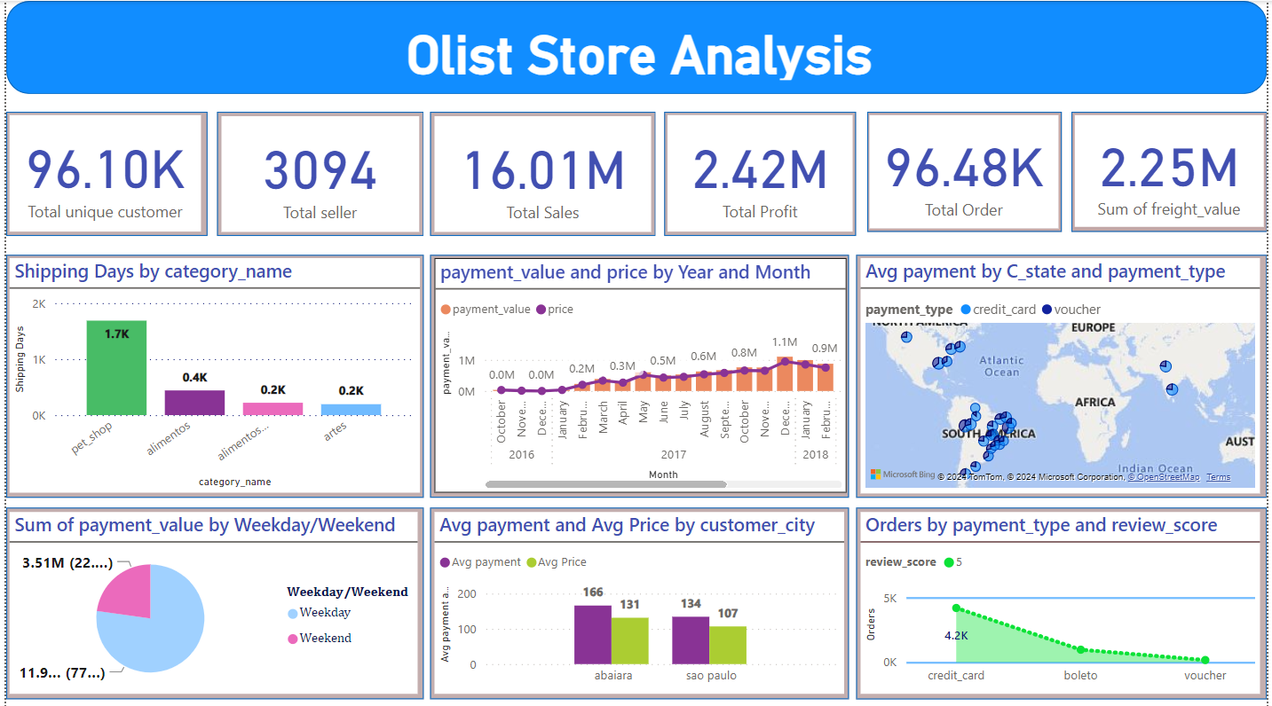
Power Bi Dashboard

Slide 12
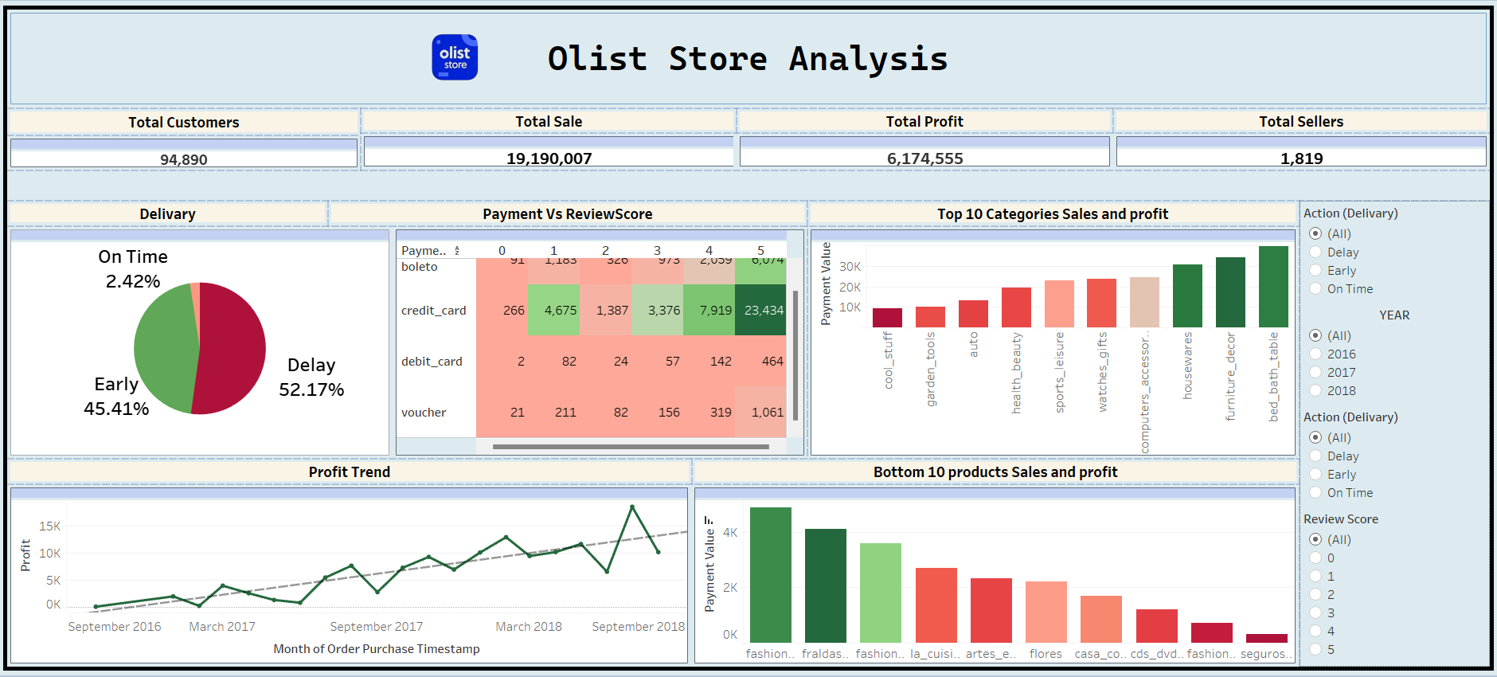
Tableau Dashboard

Slide 13
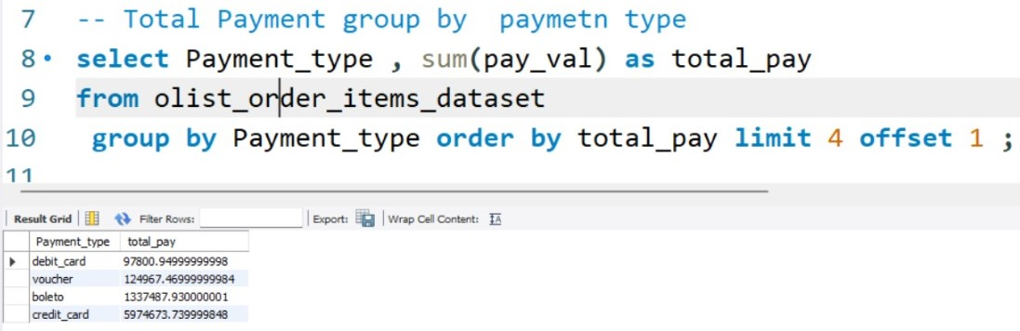
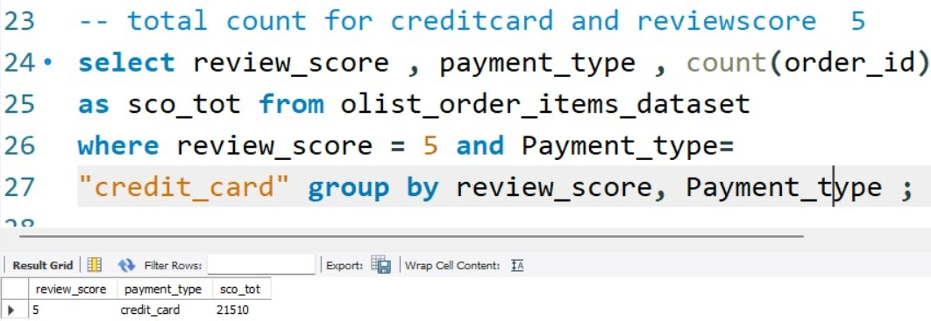
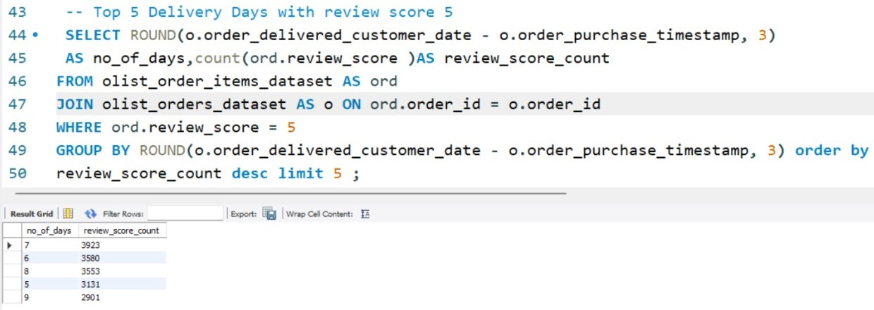
SQL
Credit card with review
score 5= 21510
Top 5 delivery days with review Score 5 are
7,6,8,5,9 days
Total payments by payment type=
DB | 97800
Voucher | 124967
Beleto | 1337487
CD | 5974673

Slide 14
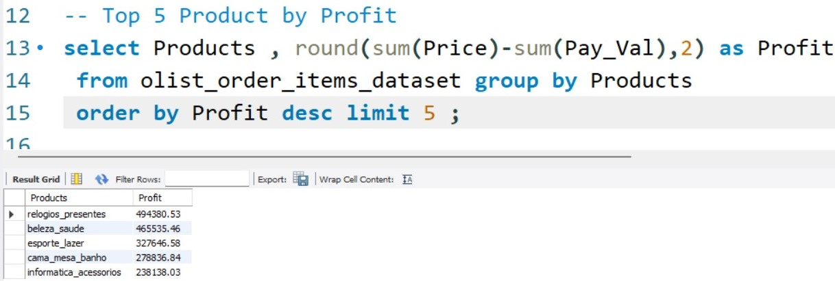
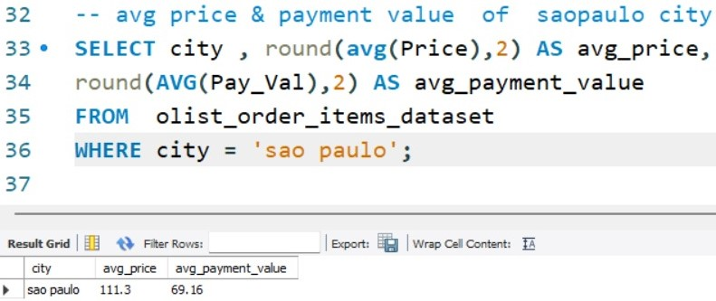
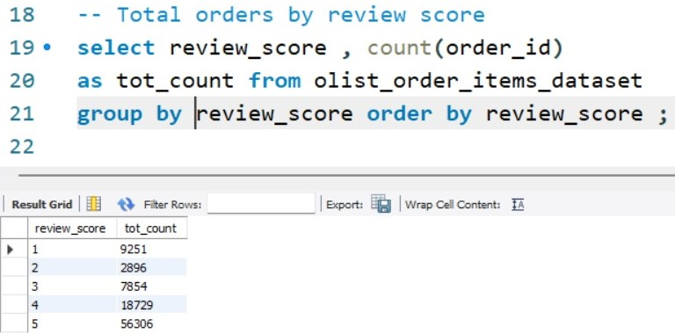
SQL
Top 5 product with profit
Sao Paulo
Avg price = 111.3 Avg payment value = 69.16
Total review score
1 | 8251
2 | 2896
3 | 7854
4 | 18729
5 | 56306

Slide 15
CONCLUSION
In our efforts to address key performance indicators (KPIs), we have acquired expertise in analyzing regional spending patterns, refining delivery operations, and elevating customer satisfaction levels. This knowledge equips us to assist Olist in maximizing growth prospects within their e-commerce framework.
Engaging with the dataset has bolstered our proficiency in e-commerce metrics, Power BI DAX, and data modeling techniques.
To tackle KPI challenges, we implemented data cleaning protocols and utilized statistical methodologies.

Slide 16


